Slide 1

Bible…
Ngashankakhui
Bible…Ngashankakhui Otsin International Inc. Fort Worth, Texas
wui tamkachithei
www.biblebasically.com
8.0.01.
©2004 TBBMI
04

Slide 2


(Azingbing hi tamkahaina.)
BIBLE… NGASHANKAKHUI
®
AKHUM KATHUM
Haokaphok kathakhala kachi nali kachithei: “THAKDA THEIKAPAI THOTWUI KHARARCHAN”
02
©2006 TBBMI
9.6.03a.
Notes:
Akhum Kathum…kala mataimeithui kachili rashung haira… Bible khararchanwui mataimeithui kachi. Ithumna THÂKLÂK EINA THEIKAPAI THOTCHANda hoya. Hina Bible kumei chili “KHI SHOKHAO”…kachi chi shalâk eina.

Slide 3

-
O
7
V
J
03
1
Notes:
Kharesada…tamkahaibing chi hanluida phaning-ungsa… 7li chuk-kahaichi…
//// …O, V kala J na kuinamda.

Slide 4
7
PHANINGUNG LUIKHAVAI...
O 7 V J
=
4 3
04
1
Notes:
Phaningung khangasak… 7 uishong achithekli khaleichi… phaningkha-ungli ngachon khavaina…
//// … 7 chi 4 kala 3 li ngakaita paiya.

Slide 5
7
PHANINGUNG LUIKHAVAI...
O 7 V J
O 4 3 V J
05
Notes:
…china O 4 3 V J shokngasak-ka…

Slide 6
7
PHANINGUNG LUIKHAVAI...
O 7 V J
O 4 3 V J
OKATHUI KASEM
4 MIBING
3 YARUIPAN
VARI KAHAI
JISHU
06
Notes:
…china maram phanga theingasaka
OKATHUI KASEM…4 MIBING…3 YARUIPAN…VARI KAHAI…JISHU

Slide 7
7
OKATHUI KASEM
ABRAHAM
JOSEPH
MOSES
JOSHUA
ROTKHAMARAT
WUNGNAO
NARKAHAI
VARI KAHAI
JISHU
07
Notes:
Kala naomeithuida… lairik sangkhavai BIBLEWUI LAIRIK-KOM.
Ili ngarumda pamilu… OKATHUI KASEM, ABRAHAM, JOSEPH, JOSHUA, ROTKHAMARAT, WUNGNAO, NARKAHAI, VARI KAHAI kala JISHU.

Slide 8
HAOPHOK
KHAVAI
KHANGARAN
10 APAM
MY
OKATHUI KASEM
6 4
ABRAHAM
N (A)
JOSEPH
H
MOSES
GN
APAM CHI
C
JOSHUA
ROTKHAMARAT
NK
B
WUNGNAO
J
NARKAHAI
“SHOKDA
KHALEI
OTSHOT
APAM”
MN
VARI KAHAI
JISHU
U
E
KB
RS
SK
PG
08
1
Notes:
Aruiva… achâlakha Israel Ngalemli khalei ngaleibingwui map naningli – HAOPHOK KHAVAI KHANGARAN – kala
//// BIBLE LAIRIK SANGKHAVAI LAIRIK-KOM khare-khanao athishurda ngaranhai… mathangli khi sa-usi?

Slide 9
7
OKATHUI KASEM
ABRAHAM
ABRAHAM
ABRAHAM
JOSEPH
ABRAHAM
MOSES
JOSHUA
ROTKHAMARAT
WUNGNAO
NARKAHAI
VARI KAHAI
JISHU
•Ithum ningwui map semkakana!
•Ithum meisa eina katam maningmana...
•Matailak kahai bingna.
•Biblewui khamatai bingna.
09
4
Notes:
//// Rimeithuida, phaningunglu, kachiya ithumhi ning eina map semdakhaleina. Chiwui thili Bible Larik-kom tharâ haklâk kahai ningwui shimsak katha akha ngasakhavai sichinna! Ithumhi Kapimewui thuklâk kahai ka-kapiwui ot hi phabtapaimei khavai TUIRARA WUI MAP kasemna.
//// Ithumhi teoda katam maningmana!
//// Ithumhi matailak kahaibing mang chi tamra…
//// …Biblewui tuirara bingmang. Kala china BIBLE NGASHANKAKHUIwui matailak kahai aman kasak chi china.
Naolak eina nana KALI kala KACHILI Varewui leikashiwui chithi awui Themsakli kapimihaili khala kachi chi tamphok haora.

Slide 10
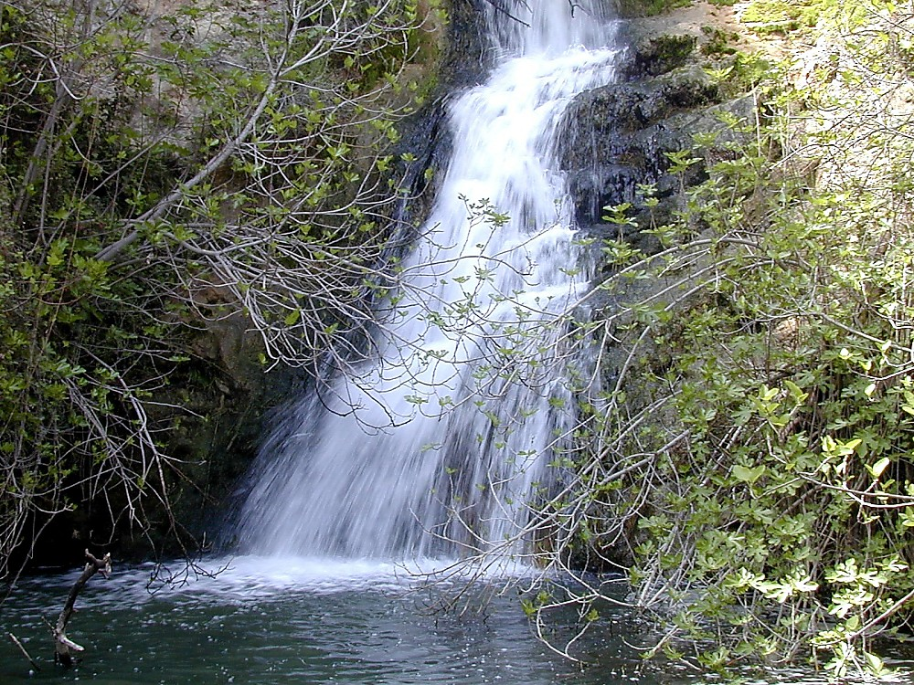
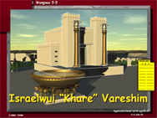
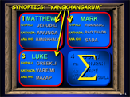
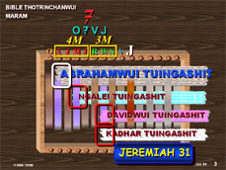
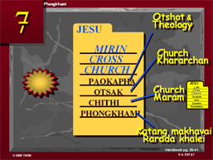

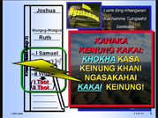
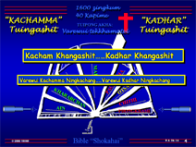
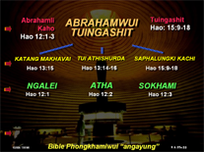
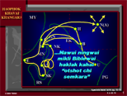
10
Notes:
Bible Lairik sangkhavai aming kapisangkahai tharâ chili pheisin sâlaga – ama tarâkha zanglaga… amawui khangachon eina… Biblewui khamataiya otshot khari-khanao tam-ura, matailâk kahai khararchanbing. Ithumwui khamataiya kharinchi ningli hailu: Bibleli matailâk kahai khararchanbing mang kala matailâk kahai mibing mang chi tamda khaleina. Nana khararchan kala mibinghi zangmaraowada phaningkasa tarâkha mazang masâmara. Kha tamda khaleiwui lungli makazanga athumwui apamla leidalei. Kala katongahi ningwui khutlai khari-khanao athishurda sichinlaga katamna.
[“chonsa” khayinga maju eina chithei kahai china khanaowana]

Slide 11
OKATHUI KASEM
ABRAHAM
ABRAHAM
ABRAHAM
JOSEPH
ABRAHAM
MOSES
JOSHUA
ROTKHAMARAT
WUNGNAO
NARKAHAI
VARI KAHAI
JISHU
11
Notes:
Kala ithumna Thaklâk eina Theikapai Thotchan katamli –BIBLE LAIRIK-KOMli pheisin salaga – nana akaibing chi ngasunkhuishap haora – shok-kahai otshot kala mibing chi – matailâk kahai tuibingli BIBLE LAIRIK SANGKHAVAIli ngarumda.
Khare-khanao nana tamkhui kahai athishurda.

Slide 12
7
OKATHUI KASEM
ABRAHAM
ABRAHAM
ABRAHAM
JOSEPH
ABRAHAM
MOSES
JOSHUA
ROTKHAMARAT
WUNGNAO
NARKAHAI
VARI KAHAI
JISHU
12
Notes:
Khare china OKATHUI KASEMwui lairik-kom china. Hina otshot shok-kahaiwui khare-khanao athishurda kaphaningwui haokaphok ngasâra.

Slide 13
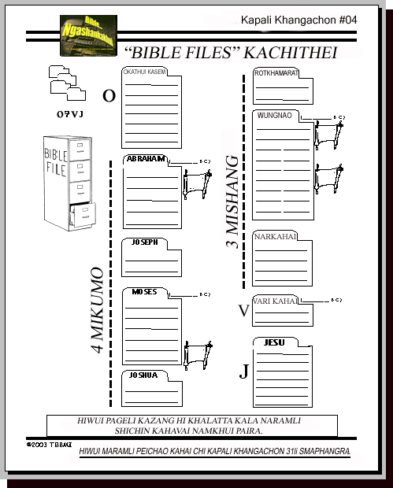
7
Hao. 1 eina thuilaga 11 eina tangda
CREATION
ABRAHAM
ABRAHAM
ABRAHAM
OKATHUI KASEM
JOSEPH
ABRAHAM
MOSES
JOSHUA
ANARCHY
ROYALTY
CAPTIVITY
SILENCE
JISHUS
KAPÂLI KHANGACHON 04
13
1
Notes:
Katamnaowui katamli ngachon khavai lairk BIBLE LAIRIK-KOMBING ZANKAHAI – KATAMLI KHANGACHON MASHING 4 – chi singdalei-akha,
Akhum mathang mathang tamkhavaili hengsada yangpai khavai napangli hailu. Bible lairik katongal chi chili zangserra.
China nali thakmeida THALÂK EINA THEIKAPHAI THOTCHAN chi ningli phung ngasakra… OKATHUI KASEMwui lairik-kom eina haophokda.
/// Ara Bible Larik-kom bingchi mataisang khavai sa-usa, peikhamei khararchan ngarumsangmamânda, tamkahaibingli ngarumsangmamânda,
Chiyakha chuida katamchi rinmamânlaga, Biblewui tuirara bingchi pheisa.

Slide 14
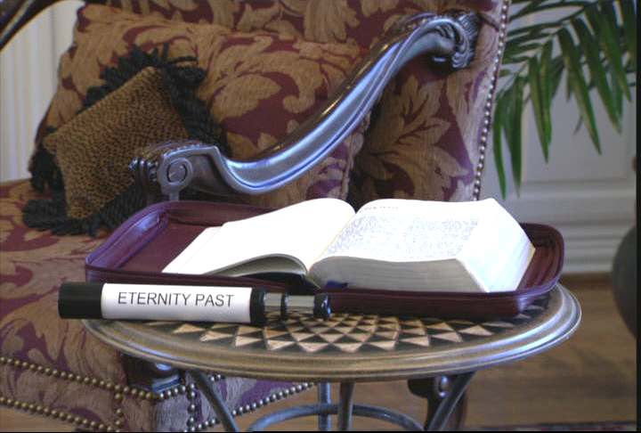
7
HAO 1-11: THUIKAHAI
KATANG MAKHAVAI ATAM
THUIKAHAI KATANG
MAKHAVAI ATAM
Ngasoda kazat lairik pg.17-19
1
14
Notes:
OKATHUI KASEM LAIRIK-KOMLI, thaklâk eina, Haokaphok wui kapikasang tharada akha chi yangsa. Ithumna apuk-apak hi mashâchao eina theiya… kala…
//// katângashan yangkhavai akap eina haokaphokli kapisang kahaibing chi katang makhavai thuikhaili shok-kahaili ngashân yangsa… Haokaphok kala naoda Phongkhamili katângashan yangkhavai akap eina haklâk kahai atam chi ngashân yangra. [Varena katang makhangavâ atam eina okathui semma]

Slide 15
THUIKAHAI KATANG MAKHAVAI ATAMLI YANGKHAUNG...
Ngasoda kazat lairik pg.17-19
15
Notes:
Katângashan yangkhavai akap thuikahai katang makhavai atamli khayang hi, kaphung katâli khangashân eina ngaraiya.
Kaphungtonbingchi mathang-mathang eina pareng eina ithumna katawui eina theiya.

Slide 16
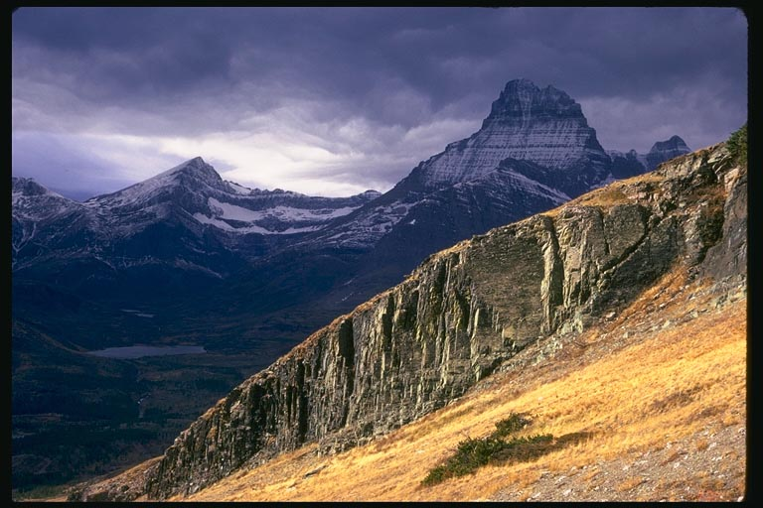
THUIKAHAI KATANG MAKHAVAI ATAMLI YANGKHAUNG...
Ngasoda kazat lairik pg.17-19
1
16
Notes:
Kaphungton bingwui ngachaili ngalei mashâlâk kahai lei kachi chi ithumna theiya.
//// kha ithumna kaphungton bingwui ngachaili khalei ashât chili vakazang eina shengmeida apambing chi theiya…
Kala kaphungton bingwui ngachaili khalei ashâtbing chiwui katâchi tamkhavai.

Slide 17
Hao. 1:1
“Haokaphok
li...”
17
1
©2006 TBBMI
8.0.03a.
Notes:
Chithada sada…OKATHUI KASEMWUI BIBLE LAIRIK-KOM khayangli… Haokaphok1:1…
//// …ithum “Haokaphokli leidalei…” tuipâ akha china phaninglala makakhui Thot kachidawui khangaran kasâ chi charfa kachon thada shomiya…

Slide 18
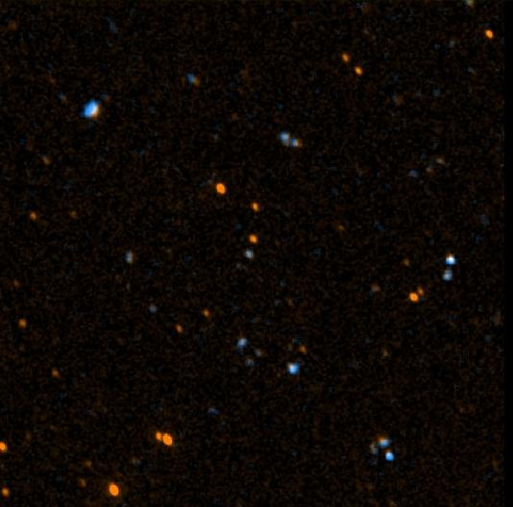
John 17:5
“Chieina ara Ava, apuk-apakva maleiranglakha nali ngasoda ina tekmateida leikasâ chieina nawui mangali ili tekmatei ngasakmilu.”
18
©2006 TBBMI
8.0.03a.
Notes:
Haokaphokwui mangali okathui maleisârang kachi atam thada ithumna theiya. Jishuna chikatha atamchi shakhi saya. Ithumna chithaya da theiya kachiya Avâva li Ana ngahan-na – John 17li – ali tekmateingasak khavai “apuk-apakva maleiranglakha nali ngasoda ina tekmateida leiksâ chieina nawui mangali ili tematei ngasakmilu.” [John 17:5]

Slide 19

John 17:5
“Chieina ara Ava, apuk-apakva maleiranglakha nali ngasoda ina tekmateida leikasâ chieina nawui mangali ili tekmatei ngasakmilu.”
19
©2006 TBBMI
8.0.03a.
Notes:
Haokaphokwui mangali okathui maleisârang kachi atam thada ithumna theiya. Jishuna chikatha atamchi shakhi saya. Ithumna chithaya da theiya kachiya Avâva li Ana ngahan-na – John 17li – ali tekmateingasak khavai “apuk-apakva maleiranglakha nali ngasoda ina tekmateida leiksâ chieina nawui mangali ili tematei ngasakmilu.” [John 17:5]
[ANING SA-SAK EINA MATHANG SHOKHAORA]

Slide 20
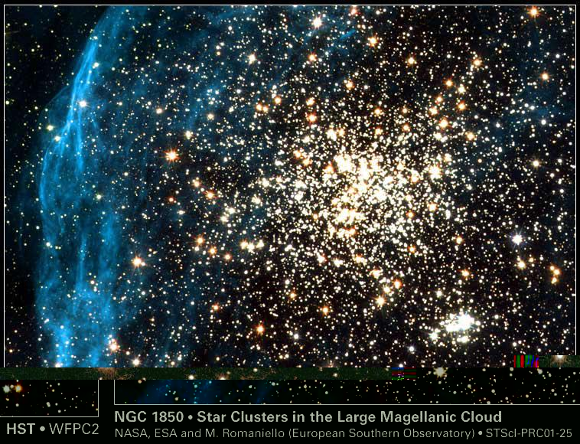
John 17:5
“Chieina ara Ava, apuk-apakva maleiranglakha nali ngasoda ina tekmateida leikasâ chieina nawui mangali ili tekmatei ngasakmilu.”
20
©2006 TBBMI
8.0.03a.
Notes:
Haokaphokwui mangali okathui maleisârang kachi atam thada ithumna theiya. Jishuna chikatha atamchi shakhi saya. Ithumna chithaya da theiya kachiya Avâva li Ana ngahan-na – John 17li – ali tekmateingasak khavai “apuk-apakva maleiranglakha nali ngasoda ina tekmateida leiksâ chieina nawui mangali ili tematei ngasakmilu.” [John 17:5]
[ANING SA-SAK EINA MATHANG SHOKHAORA]

Slide 21

John 17:5
“Chieina ara Ava, apuk-apakva maleiranglakha nali ngasoda ina tekmateida leikasâ chieina nawui mangali ili tekmatei ngasakmilu.”
21
©2006 TBBMI
8.0.03a.
Notes:
Haokaphokwui mangali okathui maleisârang kachi atam thada ithumna theiya. Jishuna chikatha atamchi shakhi saya. Ithumna chithaya da theiya kachiya Avâva li Ana ngahan-na – John 17li – ali tekmateingasak khavai “apuk-apakva maleiranglakha nali ngasoda ina tekmateida leiksâ chieina nawui mangali ili tematei ngasakmilu.” [John 17:5]
[ANING SA-SAK EINA MATHANG SHOKHAORA]

Slide 22
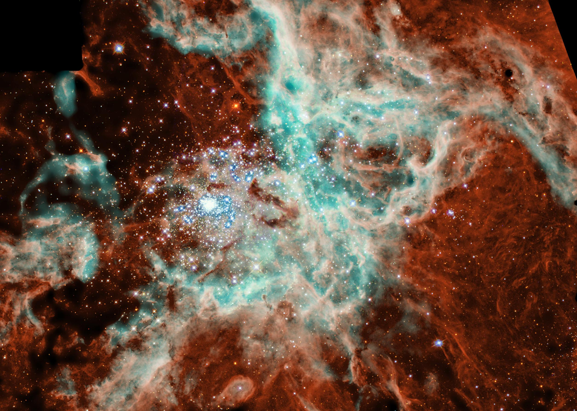
John 17:5
“Chieina ara Ava, apuk-apakva maleiranglakha nali ngasoda ina tekmateida leikasâ chieina nawui mangali ili tekmatei ngasakmilu.”
22
©2006 TBBMI
8.0.03a.
Notes:
Haokaphokwui mangali okathui maleisârang kachi atam thada ithumna theiya. Jishuna chikatha atamchi shakhi saya. Ithumna chithaya da theiya kachiya Avâva li Ana ngahan-na – John 17li – ali tekmateingasak khavai “apuk-apakva maleiranglakha nali ngasoda ina tekmateida leiksâ chieina nawui mangali ili tematei ngasakmilu.” [John 17:5]
[ANING SA-SAK EINA MATHANG SHOKHAORA]

Slide 23
Job 38:4-18
“Ina Okathui semkaphok chitharan na kali leisa?”
CREATION
23
1
©2006 TBBMI
8.0.03a.
Notes:
Laga…mikumona akhalattawui kathem thangkhamei chiwuivang okathui hili langso ngayila; Kasâ-Akhavâna Jobli pailâk kahai khangahân hi saya…“Ina Okathui semkaphok chitharan na kali leisa?”

Slide 24
Hao 3:15:…”ana nakui naikhaira kala nana awui pheimajali makeira.”
NIVli hithada ngarumsanga: “Shanaowui thara akhana pharawui akui naikhaimi haowa; Ngashit kahai hi Christana Satanli khayuili ungshunga – shitkasanga katongana hiwui khayui hi mazap kakhui samphangra (Rom 16:20).
Hao. 1-11
OKATHUI KASEM
Atam katonga hi Abrahamwui mamanglina
CREATION
1st MAYARNAO & SHANAO
(Tazak kahai)
1st MOREI
(Vareli ngakaikashi)
OKATHUI KASEM
ABRAHAM
1st PAO KAPHA
(Ngatangkhami)
OTSHOT 7
1st SHIMKHUR
(Khanganang)
1st SAKATHAT
(Zakshimeithui kachi morei)
TARA KAPHONG/CHANGI-MAHUT
(Pgm #1: Noah)
TOLAN SHIM
(Pgm #2: Babel)
Ngasoda kazat lairik pg.42-45
10
24
Notes:
CHITHADA… ithumna khare lairik sangkhavai akong, OKATHUI KASEM, Haokaphok 1-11 chi kasho eina… BIBLE LAIRIK SANGKHAVAI LAIRIK-KOM ama chi chakâ leiya
//// ….ayur shiniwui vang.
//// Zingkum 2000BC wui mamâng bingchi – Abrahamwui-mamâng atam hoya.—hi Haokaphok kapikasang tharâda akhali zanga. Atam chi khinakhala karankha khala kachi chi matheirar mana. OKATHUI KASEM wui khararchan eina thuilaga mikumona pânkhare atam chi Haokaphok 1 eina thuilaga 11 tashungdali kapisang haiya. Kha chiyakha shada kapihailala, tuibing chi aman saklâk kahai tui ngasaya khiwuivang khala chiakha ‘haophok khare” saikorawui ithumli tamchitheimiya.
RIMEITHUI KACHI BINGWUI eina haophokda…
//// RIMEIKAP KACHI MAYARNAO KALA SHANAO
Mikumo hi morei maleilâkla mathasek eina semkhuiya kala morei makhalei Varewui themsak mathasek kahai apam okathuili ra-okthui.
//// MOREI KHARE
Mikumoli kakapangwui pangshap mikahai chi Varena châng tamma. Ali Chipeena rasuiya kala mathasek eina leikasâ wui eina moreili tatunghaowa, hina ali kasem wui “kharin mâng ngasakhaowa”. Chiwuivang eina Kasâ-Akhavâ eina awui themsakbing tathui haowa.
//// KHARE CHANPAO
Kasâ-Akhavâna tatung kahai mikumoli kharewui mathasek eina, khayon maleila kala tharlâ eina leikasâ chili hanungluishit khavai Ngatangme chihorarada vaoshok-ka.
//// Haokaphok 3:15 hi mathada kathei darkâr saya: “…ana nawui akui naikhaira, kala nana awui pheimajali makeira.” NIV Study Bibleli azingli hithada verse hi chitheimihaiya: “Shanaowui naotun china phara chiwui akui naikhaira; ngashitmi kahai hi Khristana Chipeeli khayuili ungshunga…khayui hi shitkasang mi kachivawuina.”
//// KHARE SHIMKHUR
Adam eina Eve naongarâ leiya. Naongarâbing china naoda mitun-mirat shokngasak-ka kala athumbing china chipee wui pangshapna lukhamashan-leikhashe Avâ kala Kasâ-Akhavâli manganai khavai kasali ngasunra.
//// MIYUM KHARE
Morei hi zakshimeithui kachi kala sashimeithui kachi eina saya, chiya Varewui lemmet, mirin kaho hi sashiman ngasak-ka. Achâlakhawui thotchanli shok-kahai otshot khani Haokaphokwui kapikasang akha eina thuilaga tharâda akhali kapisang haidalei. Hila mikumowui kasâ-khavâli Varewui ningchuk zangda kasâna.
//// KAHAK-KA TARA KAPHONG kala CHÂNGJEENGAWUT
Ngaran-ngayei khare: Awui themsakbingna morei phungkahai wuivang eina Varena katonga sâshiman khavai saya…kala latlui haophoklui khavai saya. Mikumo katonga shimânser haowa kha mi chishat mâng hi khamashung-khangaronga Naohna thanda kankhuiya, athum Avâva Vareli ngavapda okthuiya, kala Varena tara kaphong chi suitâmaman kachi eina awui tuingashit sâda chângjeengawut chi miya. Kala chiwui thili…
//// BABELWUI DOLAN
Ngaran-ngayei kakhane: Mikumona Varewui thâk ngaraichada kâkhavai hotnaya. Varena mamayamada atui chi pangapâ ngasak haowa kala miyurbing chi ngata-teida zat-thuingasak haowa.

Slide 25
Kasha eina: OKATHUI KASEMwui lairik-komhi Varena Okathui kasem kala mikumo morei sakahaiwui khararchan-na. Varewui katang makhavai ngarankahai: Mikumo morei maleila leikasa kala Vareli nganailak eina khalei chili hankhaung.
“Hankhaungwui khararchan chi Biblewui matailak kahai khararchan-na, pao kaphawui angayungna.”
John Walvoord
Ngasoda kazat lairik pg.17-19
25
©2006 TBBMI
8.0.03a.
Notes:
Chithada sada, kasha eina: OKATHUI KASEMwui lairik-komhi Varena Okathui kasem kala mikumo morei sakahaiwui khararchan-na. Varewui katang makhavai ngarankahai: Mikumo morei maleila leikasa kala Vareli nganailak eina khalei chili hankhaung. John Walvoordna kapikahai: “Hankhaungwui khararchan chi Biblewui matailak kahai khararchan-na, pao kaphawui angayungna.”

Slide 26

7
Hao. 1 eina thuilaga 11 eina tangda
OKATHUI KASEM
ROTKHAMARAT
1st Mayarnao & Shanao
1st Morei
O
1st Pao kapha
1st Shimkhur
WUNGNAO
(1000 B.C.)
1st Sakathat
Tara kaphong/Changimahut
Tolan shim
ABRAHAM
(2000 B.C.)
3 MISHANG
O 7 V J
NARKAHAI
7 = 4 + 3
JOSEPH
4 MIKUMO
MOSES
(1500 B.C.)
(500 B.C.)
V
S
VARI KAHAI
JISHU
J
JOSHUA
Ngasoda kazat lairik pg.17-19
26
Notes:
OKATHUI KASEM lairik sangkhavai akhong chi peihaira. Kapikasang khare tharâda akha hili haklâk kahai mikumowui asak-avat katongahi lairik anâ kateokha mangli sursang kahai thada majuklu… tui kateokha mang eina pheikachithei… kha manglârin wuivanga ithumwui kaphaningli henmeikharda tamchitheimiya! Bible lairik sangkhavai hi arava peihaira.

Slide 27
©2006 TBBMI
8.0.03a.
27

